Slide 1



Work Opportunity
Tax Credit:
What Business Owners Need to Know
Presented To You On Behalf Of:

Slide 2

What is wotc?
The Work Opportunity tax credit (WOTC) is a federal income tax credit that’s available to businesses that hire members of certain “targeted” groups. Here’s how your business may be able to benefit from this potentially lucrative tax break.
The Basics:
WOTC encourages businesses to hire from certain categories of workers who face significant barriers to employment. The allowable credit amount is based on a portion of wages paid to an eligible worker during the first year of employment or, in some cases, during the first two years.

Slide 3

WOTC rules and restrictions:
Minimum hours of work. No credit is available unless the worker completes at least 120 hours of work. The credit is reduced if the individual works at least 120 hours but less than 400 hours.
Rehired workers. The credit is available only for new hires. Wages paid to an individual who was previously employed by your business and is rehired don’t qualify.
Related parties. Wages paid to certain individuals who are related to the employer or business owner don’t qualify.
Deduction of wages reported. A business can’t claim a compensation deduction for any portion of wages claimed as a WOTC. For instance, if the allowable credit for an employee is $2,400, you must deduct that amount from the employee’s total wages used as a business expense.

Slide 4

WOTC 28-Day Deadline Explained:
WOTC is an IRS federal program, and it is administered at a state level via State Workforce Agencies who handle the review, processing and distribution of certifications (or denials). State Agencies require employers, or service providers like WOTC.com, to submit WOTC applications to them within 28 days of the employee’s start date. This is to ensure timely processing of qualified applicants due to the large volume of applications that the states receive.
By not submitting your WOTC applications within the 28-day time frame, you can easily miss out on thousands of dollars on tax credits.

Slide 5

Advice To Employers:
Going forward, include the WOTC paperwork as part of your onboarding process.
When you hire someone new and have them complete their I-9, W-4, Employment Agreement etc. include the 8850, and 9061 forms.
To prevent any potential discrimination include the forms for ALL employees, not just the employees you think will qualify.
WOTC.com offers you the option of using either paper forms or e-forms. Online, or e-forms, are available in English, Spanish, and Russian versions.
Sometimes, additional forms must be submitted to the state. The paperwork can be a little overwhelming, so
it’s important to consult your tax credit consultant for assistance.

Slide 6
WOTC Targeted Groups
  Current law provides the following categories of WOTC-eligible workers:
  Qualified IV-A Recipient (TANF)
  Qualified Veteran
  Ex-Felon
  Designated Community Resident
  Vocational Rehabilitation Referral
  Summer Youth Employee
  Supplemental Nutrition Assistance Program (SNAP)
  Supplemental Security Income (SSI) Recipient
  Long-Term Family Assistance Recipient (Long-Term TANF)
  Qualified Long-Term Unemployment Recipient
  The last targeted group was added to the list under the Protecting Americans from Tax Hikes (PATH) Act of 2015. Since January 1, 2016, the WOTC has been available for hiring long-term unemployment recipients, defined as those who have been unemployed for a period of at least 27 weeks and who received state or federal unemployment benefits during all or part of that time.

Slide 7

Calculating the Credit
In most cases, the credit equals 40% of eligible wages
paid to an employee during the first year of employment,
up to a maximum of $6,000 of wages. That translates into
a maximum credit of $2,400.00 per employee. However, there are several exceptions to this general rule.
The WOTC for a long-term family assistance recipient equals 40% of eligible first-year wages up to a maximum of $10,000 (for a maximum first-year credit of $4,000) plus 50% of eligible second-year wages up to a maximum of $10,000
(for a maximum second-year credit of $5,000).
In addition, the WOTC can be based on more than $6,000 of first-year wages for several categories of qualified veterans. First-year wages means eligible wages paid for services rendered during the one-year period beginning on the day the individual starts work for the employer. The increased first-year wages can be $12,000, $14,000, or $24,000.

Slide 8
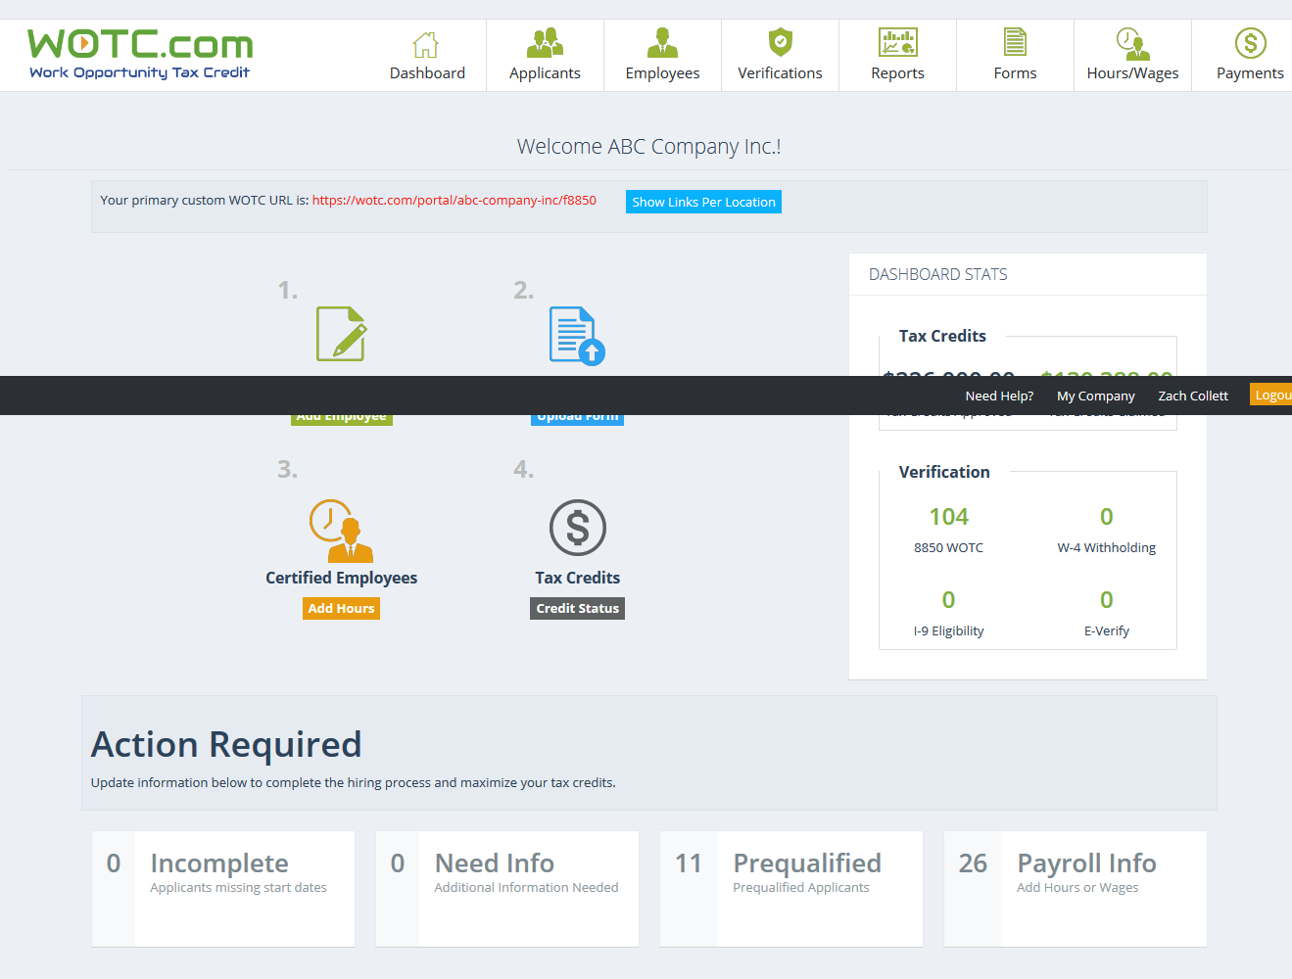
Tracking For Success!
Our dashboard’s reporting tools help employers measure their true WOTC potential

Slide 9



WOTC Process Overview:
Step 1 of 3:
Each new hire or applicant completes the 8850 form
These forms can be filled out or completed online
They must be submitted with 28 days of hire
Step 2 of 3:
Applications will be validated and submitted to the state with proof of status
Employees will be pre-qualified, certified, or denied
All pre-qualified and certified employees should be given the appropriate
amount of hours and wages to get the maximum tax credit
Step 3 of 3:
Payroll will be collected for all certified employees.
Completed IRS forms are generated and sent to the company for filing

Slide 10
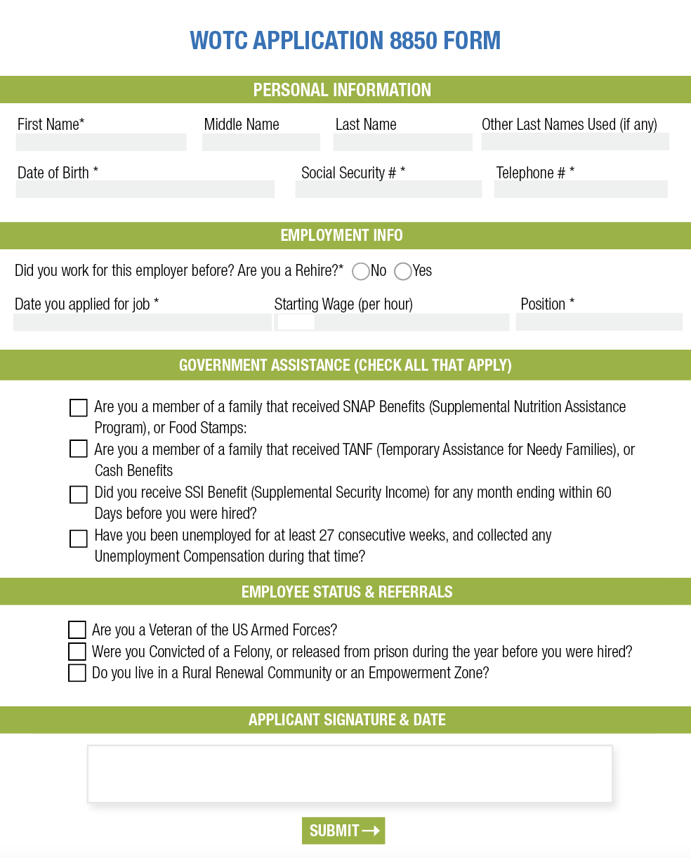
Step 1: Paper or E-Form
Each new hire completes an IRS form 8850.
These forms can also be completed online at WOTC.com. Each client is provided an online portal customized with their own logo.
Forms are available in English, Spanish, and Russian.
Forms must be submitted to WOTC.com or through the online portal within 28 days of the employees start date. The IRS does not accept applications submitted after the 28 day deadline.
Paper forms can be emailed, mailed, faxed, or uploaded to WOTC.com.

Slide 11
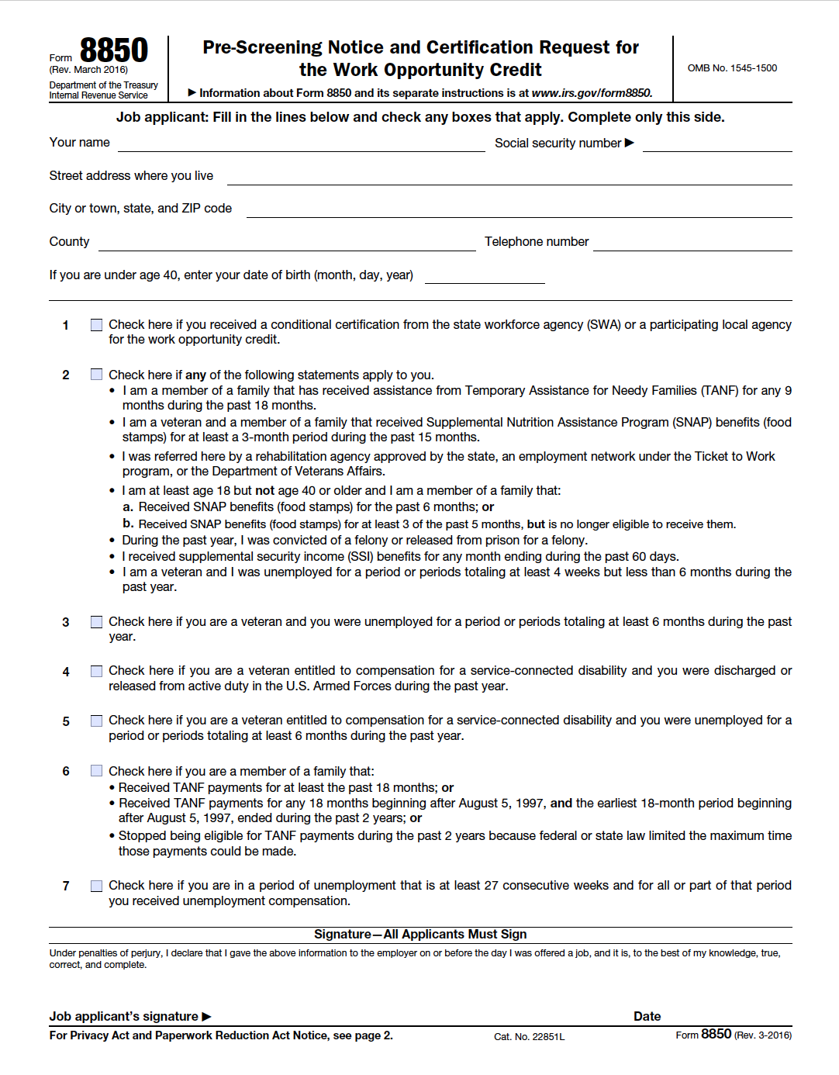


Slide 12
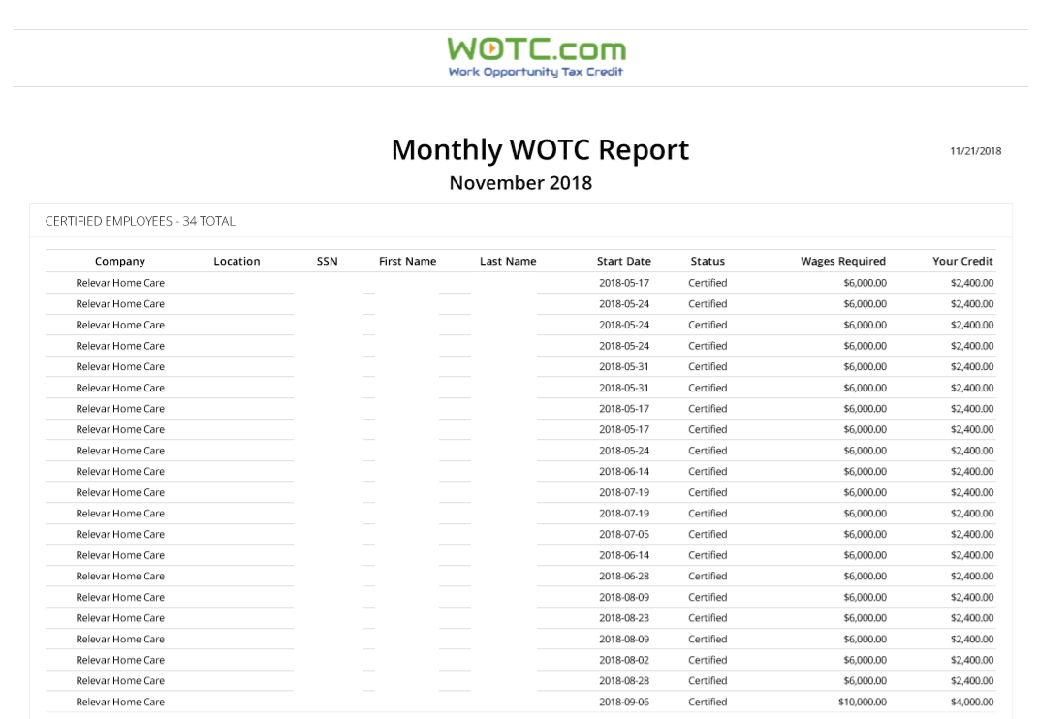
Step 2: Tracking WOTC Tax Credits
A WOTC.com team of accounting professionals will review the applications and submit to the state agencies with backup documentation as needed.
WOTC.com works hard to get employees certified and will update clients with monthly reports.
Monthly reports help clients keep track of employees that are an asset to you company.

Slide 13
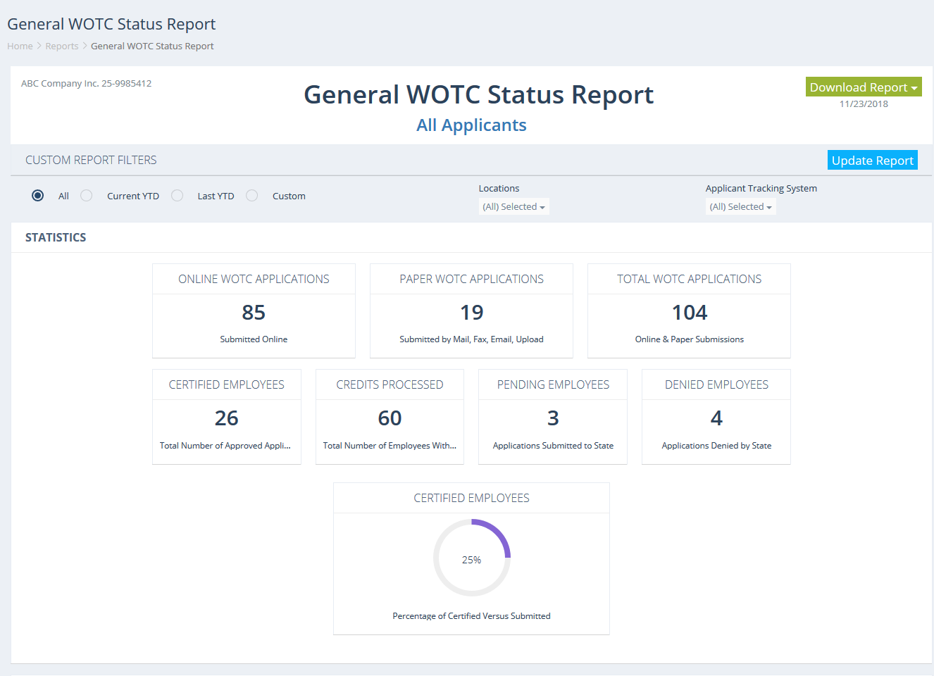
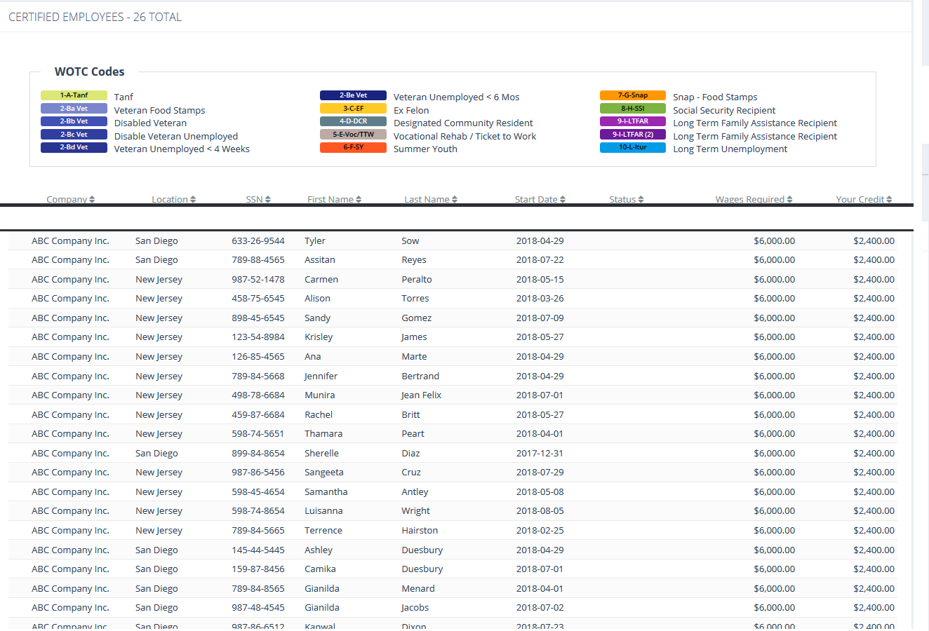
Follow The Trail:
Aside from getting detailed analytic reports to their email every month,
our clients are able to track their success live through WOTC.com.

Slide 14
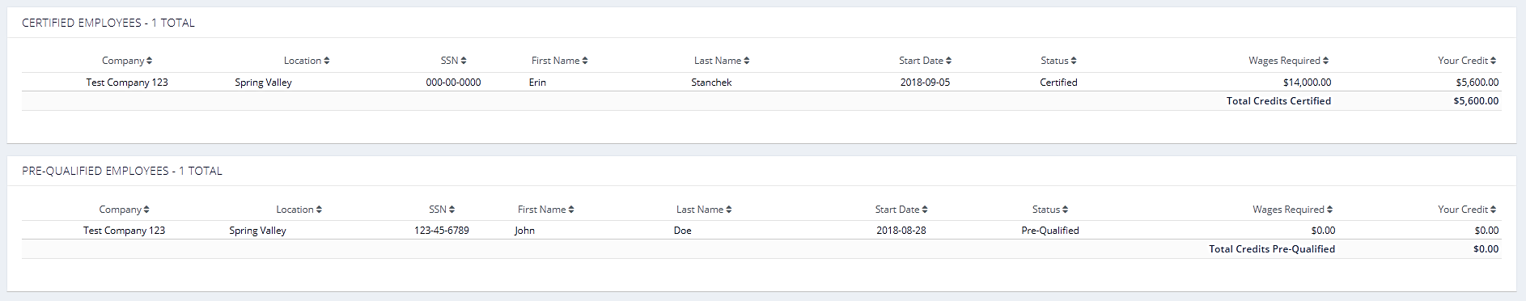
Pre-Qualified and Certified
Once an employee is Pre-Qualified or Certified they should be given hours and wages.
Monthly Reports are emailed to the administrative owners of the account and are available in the clients WOTC portal.
The list of Pre-Qualified and Certified employees should be forwarded to the companies scheduling coordinator

Slide 15
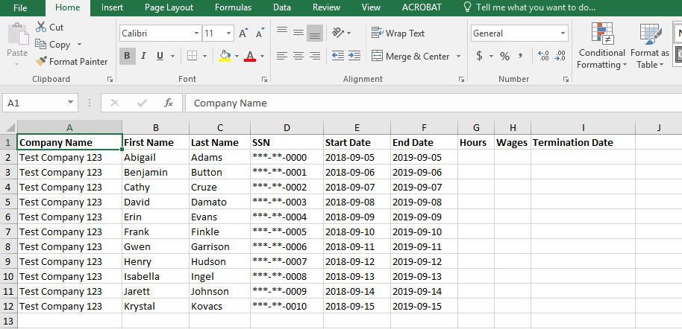
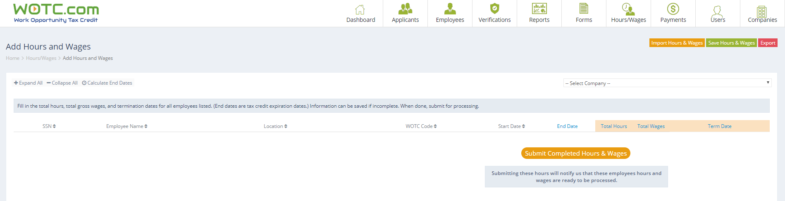
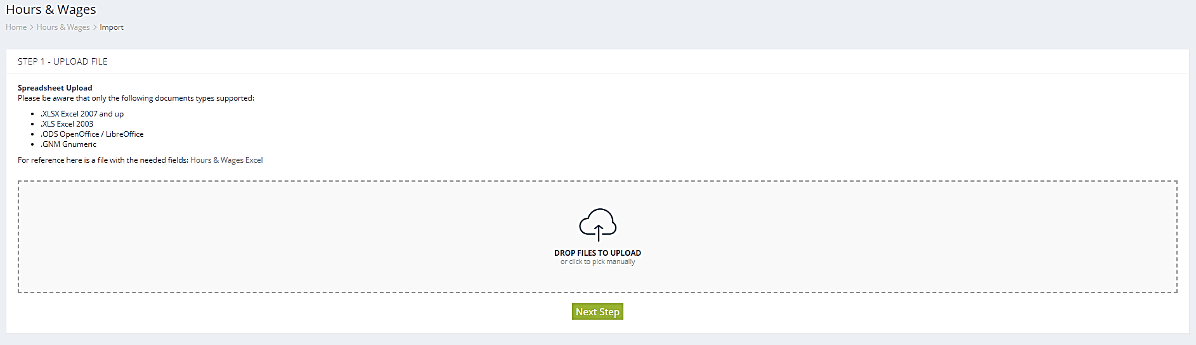
Payroll
STEP 3: CALCULATING THE WOTC CREDIT
Clients are given the option to provide payroll for their certified employees once a month, once a quarter, or once a year.
A payroll request for hours and wages can be emailed to you or exported from the client’s WOTC portal.
Existing payroll reports can be uploaded into the client’s WOTC portal prior to generating credits.

Slide 16
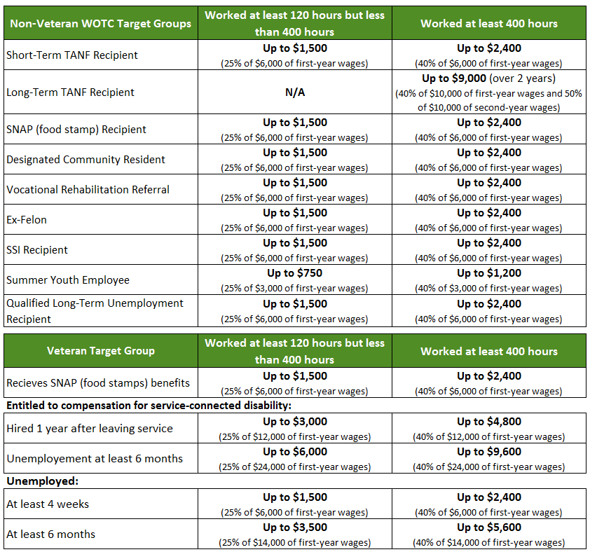
Hours and Wages
Employees who work a minimum of 120 hours are eligible for a partial tax credit.
Employees who work a minimum of 400 hours are eligible for the max credit.
Credit is calculated using a set percentage of wages.

Slide 17
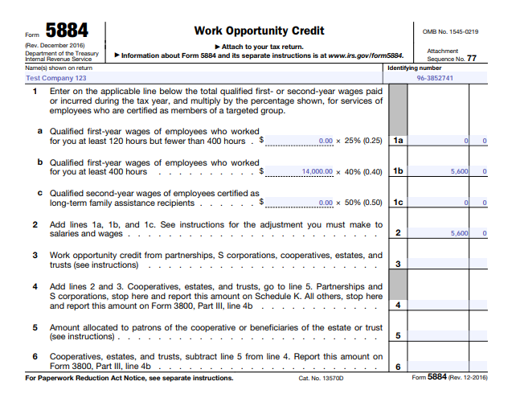
IRS Tax Form 5884 Created
When a credit is ready to be issued to a
client we will prepare tax form 5884.
We will forward this form to the client’s
CPA or accounting department to be processed filed along with the tax return.
Many times complex questions will arise.
Our team of accounting professionals will guide your CPA on how to claim these credits.

Slide 18



WOTC.COM team of professionals
ROBERT DELLAGRECA
Sales and Implementation Specialist
David gross
Director of IT & Integrations
Rose Markowits, FPC
Senior Accounting Specialist
212-635-9500 ext. 212
Robert@wotc.com
212-635-9500 ext. 220
David@wotc.com
212-635-9500 ext. 202
Rose@wotc.com

Slide 19

Thank you
info@wotc.com
https://www.wotc.com

